Slide 1
Pre-processing :
RegArima modelling in Tramo and in X12/X13
ESTP Training
05-07 October 2026

Slide 2
Outline
Why pre-processing (with RegArima)
RegArima model
  Definition, estimation
Automatic model identification (AMI)
  Overview, seasonality tests, log/level, calendar effects, outliers, ARIMA models, final checks
Final remarks

Slide 3
1. Why pre-processing?
Exercise:
  Effects of log/level, trading days, outliers on the final SA series (trend, irregular…)
  Impacts using Tramo-Seats and X12-Arima

Slide 4
1. Why pre-processing?
 | X12 | Tramo-Seats
Log/level
Trading days
Outliers

Slide 5
1.2. Why RegArima?
Flexible and parsimonious
Efficient estimation procedures
Historical reasons
  Link with SEATS and the canonical decomposition
More powerful alternatives could now be considered (structural models…)

Slide 6
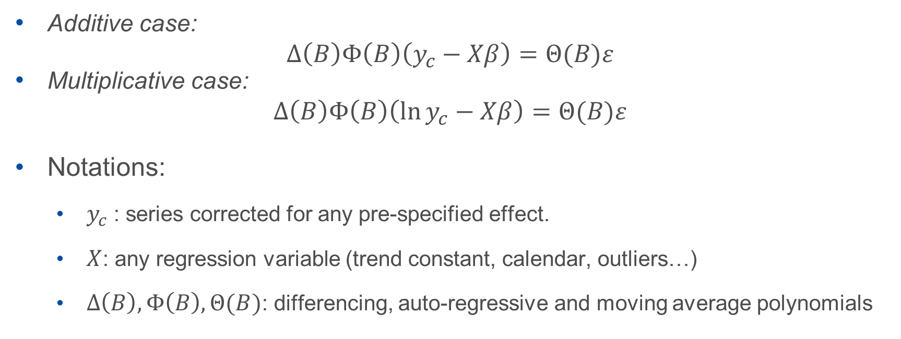
2.1 RegArima model
Additive case:
$$∆\left(B\right)Φ\left(B\right)\left(y_{c}−Xβ\right)=Θ(B)ε$$
Multiplicative case:
$$∆\left(B\right)Φ\left(B\right)\left(\ln{y_{c}}−Xβ\right)=Θ(B)ε$$
Notations:
  $y_{c}$ : series corrected for any pre-specified effect.
  $X$: any regression variable (trend constant, calendar, outliers…)
  $∆\left(B\right), Φ\left(B\right),Θ(B)$: differencing, auto-regressive and moving average polynomials

Slide 7
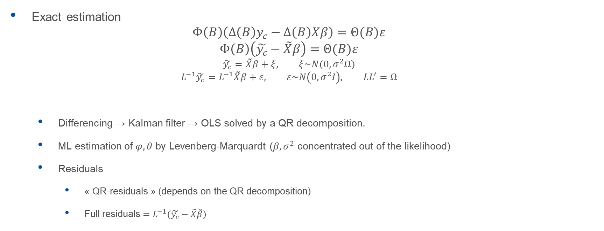
2.2 RegArima estimation (I)
Exact estimation
  $$Φ\left(B\right)\left(∆\left(B\right)y_{c}−∆\left(B\right)Xβ\right)=Θ(B)ε$$
  $$Φ\left(B\right)\left(\tilde{y_{c}}−\tilde{X}β\right)=Θ(B)ε$$
  $$\tilde{y_{c}}=\tilde{X}β+ξ, ξ\sim N(0, σ^{2}Ω)$$
  $$L^{−1}\tilde{y_{c}}=L^{−1}\tilde{X}β+ε, ε\sim N\left(0, σ^{2}I\right), LL^{′}=Ω$$
  Differencing → Kalman filter → OLS solved by a QR decomposition.
  ML estimation of $φ, θ$ by Levenberg-Marquardt ($β,σ^{2}$ concentrated out of the likelihood)
  Residuals
    « QR-residuals » (depends on the QR decomposition)
    Full residuals $=L^{−1}(\tilde{y_{c}}−\tilde{X}\hat{β})$
!

Slide 8
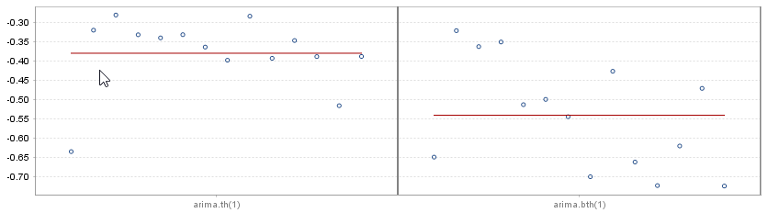
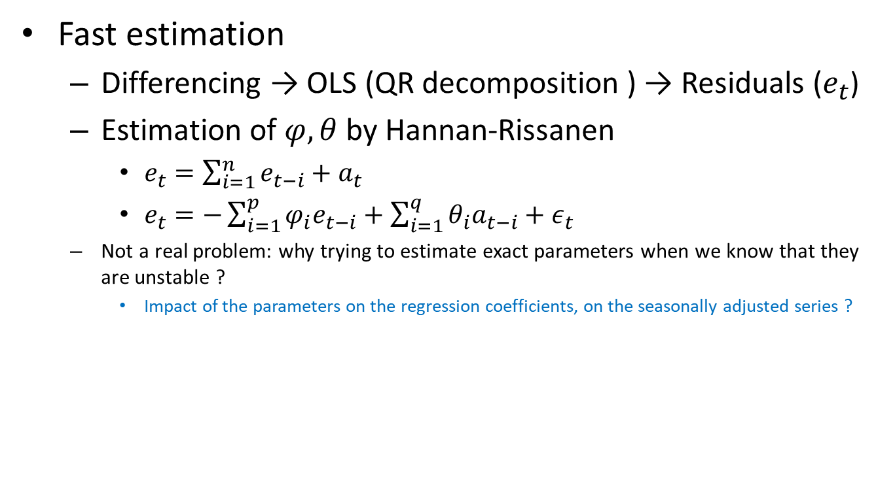
2.2 RegArima estimation (II)
Fast estimation
  Differencing → OLS (QR decomposition ) → Residuals ($e_{t}$)
  Estimation of $φ, θ$ by Hannan-Rissanen
    $e_{t}=\sum_{i=1}^{n}{e_{t−i}}+a_{t}$
    $e_{t}=−\sum_{i=1}^{p}{φ_{i}e_{t−i}}+\sum_{i=1}^{q}{θ_{i}a_{t−i}}+ε_{t}$
  Not a real problem: why trying to estimate exact parameters when we know that they are unstable ?
    Impact of the parameters on the regression coefficients, on the seasonally adjusted series ?

Slide 9
2.2 RegArima estimation (III)
X12-Arima
  Exact ML estimation
Tramo
  Fast estimation in most intermediary steps
  Exact ML estimation in final steps

Slide 10
3.1 AMI: simplified schema
Initialization
Seasonality tests
Log/level
Regression (TD, Easter…)
Differencing
Arma identification
Outliers detection
Model checks
Final estimation

Slide 11
3.2 Seasonality tests
Only in the last versions of Tramo and in JD+
Initial tests
  Ljung-Box test: auto-correlations at seasonal lags
    Correlations between (y(t), y(t-s)), (y(t), y(t-2*s))
  Friedman (non parametric) test

Slide 12

3.3 Log-level test (I)
Tramo
SsqErr comparison
(fct)
Levels:
Airline+mean
Logs:
Airline+mean
Logs: SsqErr
*correction factor
$$SsqErr ∝likelihood$$
X13
AICC comparison
Levels:
Airline+mean[+regs…]
Logs:
Airline+mean[+regs…]
Logs: likelihood
+correction factor*
$$AICC=−2∙\left(loglikelihood−n∙np/(n−np−1)\right)$$

Slide 13
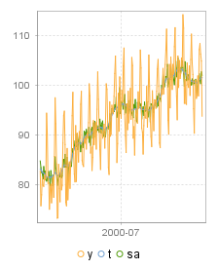
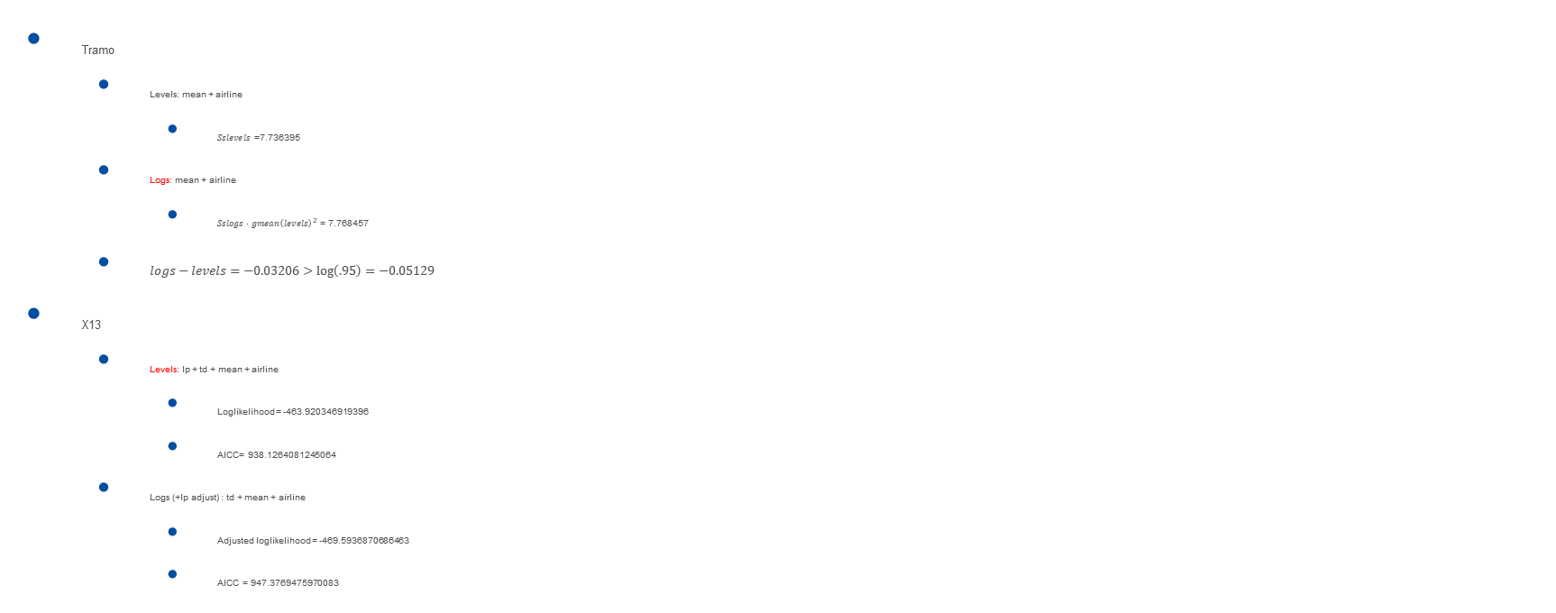
3.3 Log-level test (II)
Tramo
  Levels: mean + airline
    $Sslevels$ =7.736395
  Logs: mean + airline
    $Sslogs∙{gmean\left(levels\right)}^{2}$ = 7.768457
  $logs−levels=−0.03206>\log\left(.95\right)=−0.05129$
X13
  Levels: lp + td + mean + airline
    Loglikelihood = -463.920346919396
    AICC= 938.1264081245064
  Logs (+lp adjust) : td + mean + airline
    Adjusted loglikelihood = -469.5936870686463
    AICC = 947.3769475970083

Slide 14

3.4 Regression (calendar) tests (I)
Tramo
  Legacy code:
    T-tests on trading days, leap year, Easter variable
  New tests:
    F-tests on trading/working days,
    T-tests on trading days, leap year, Easter variable
JD+
  Also Wald tests on trading/working days

Slide 15
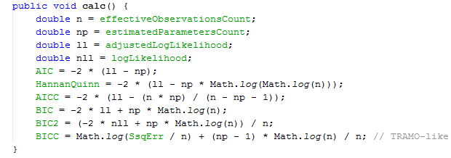
3.4 Regression (calendar) tests (II)
X12
  AIC comparison between:
    Models with and without trading days
    Models with different Easter variables (length=1, 8, 15)
    Models with other regression variables

Slide 16
3.5 Outliers detection
Types of outliers
  AO, LS, TC, SO (SLS and IO not supported)
Impact of outliers
  Estimated parameters
    Forecasts…
  Specific SA issues
Solutions
  ML-based solutions
  [Robust estimates]
Issues
  Unstable algorithms
  « Masking » effects

Slide 17
3.5 Outliers detection in Tramo
Model estimation
HR or ML
Computation of filtered residuals
OLS with « quasi » filtered outliers
No
Computation of robust T-Stats
Max T < VA
Remove 1 outlier
Yes
Model estimation
HR or ML
Add 1 outlier
Max T > VA
Yes
No
Remove less (<VA) significant outlier

Slide 18
3.5 Outliers detection in X12
Model estimation
By ML
GLS with all outliers (1 by 1)
Computation of robust T-Stats
Add 1 outlier (or all outliers)
Yes
Max T > VA
No
Remove less (<VA) significant outlier

Slide 19
3.5 Outliers detection. Key points
ML or HR estimation
Computation of robust stdev on the residuals
Regression on residuals or on complete models
Back calculation to identify masking effects
Exact or approximate GLS estimation

Slide 20
3.61 Differencing
Tramo ~ X12
Step 1:
  Estimate (2 0 0)(1 0 0)+mean
  Select root(s) : 1/|r| > initial UR (0.97)
Step 2:
  Estimate (1 x 1)(1 y 1)+mean
  Cancel similar AR, MA roots (cancel)
  Select root(s) : 1/|r| > final UR (0.91)

Slide 21
3.62 ARMA identification
Tramo ~ X12
Computes BIC (Tramo-like) for different ARMA orders
  Estimation of the models:
    Tramo: Hannan-Rissanen
    X12: exact ML
Best (acceptable) model selected

Slide 22
3.7 Final checks
Suppression of non-significant ARIMA parameters
Regular/seasonal under-differencing (quasi-unit roots)
Seasonality control
Residual trading days (F-test on the residuals)
Benchmarking with reference (airline) models
  Criterions: BIC , outliers, LjungBox, Seasonal LjungBox, Skewness

Slide 23
4. Final (personal) remarks
Wonderful “expert system”
But…
  Several known weaknesses
    Log/level in case of large outliers
    Trading days selection (Tramo)
    Outliers (not robust enough)
    Selection of non decomposable models
    …
But…
  Not easy to outperform the current algorithms

Slide 24
4. Final (personal) remarks
Avoid complex models (too unstable)
Impact of the ARIMA model on the regression coefficients usually limited
ARIMA coefficients unstable →pragmatic approach for
  Time span, revision policies, accuracy of the estimation…
Fixed regression coefficients (TD) is an annoying limitation → structural models

